Slide 1
Unit-6
Self Organizing Maps
By: Arjun Saud
Asst. Prof.: CDCSIT, TU

Slide 2
Introduction of SOM
A self-organizing map (SOM) is a type of ANN that is trained using unsupervised learning to produce a low-dimensional (typically two-dimensional) discretized representation of the input space of the training samples.
This low dimensional representation can be viewed as a map. Therefore SOM is a method to do dimensionality reduction.
Self-organizing maps differ from other artificial neural networks as they apply competitive learning as opposed to error-correction learning.

Slide 3
Introduction of SOM
In SOM all inputs are fully connected with the output neurons and those neurons competes with each other. An output neuron that win the competition is called winning neuron or winner takes all neuron.
Synaptic weights are adjusted in the favor of winning neuron so that when same or similar input pattern is presented to the neuron there will be high chance of winning the competition for the neuron.
This means weights of winning neurons are updated such that Euclidean distance between the input and weights of the neuron is minimized.

Slide 4
Introduction of SOM
In SOM, output neurons are organized in the form of one or two dimensional lattices. Higher dimensional lattices of neurons are also possible but are not practically common.
SOMs are commonly used as visualization aids. They can make it easy for us humans to see relationships between vast amounts of data.
Example: World Poverty Map
A SOM has been used to classify statistical data describing various quality-of-life factors such as state of health, nutrition, educational services etc. Countries with similar quality-of-life factors end up clustered together.

Slide 5
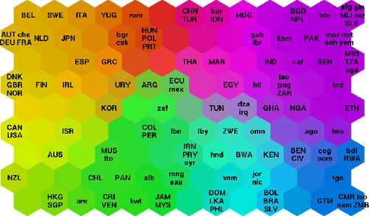
Introduction of SOM

Slide 6
Self Organizing Maps
The main goal of the SOM is to transform an incoming pattern of arbitrary dimension into a one- or two- dimensional discrete map, and to perform this transformation adaptively in a topologically ordered fashion.
Each output neuron is fully connected to all the source nodes in the input layer.
This network represents a feedforward structure with a single computational layer consisting of neurons arranged in a 2D or 1D grid.

Slide 7
Self Organizing Maps
The algorithm which is responsible for the self-organization of the network is based on three essential steps:
Competition: For each input pattern, the neurons in the network compute their respective values of a discriminant. The neuron with the largest value of discriminant function is declared winner of the competition.
Cooperation: The winning neuron determines the spatial location of a topological neighborhood of excited neurons. This is definitely cooperation because exited neuron not only strengthen itself but also it strengthens neighboring neurons.

Slide 8
Self Organizing Maps
Synaptic Adaptation: This mechanism enables the excited neurons to increase their individual values of the discriminant function in relation to the input pattern through suitable adjustments applied to their synaptic weights.
Let us examine mathematical modeling of each of above mechanism used in self organizing maps.

Slide 9
Self Organizing Maps
Competition
Let m be the dimension of the input space. A pattern chosen randomly from input space is denoted by:
x=[x₁, x₂,…, x_{m}]^{T}
The synaptic weight of each neuron in the output layer has the same dimension as the input space. We denote the weight of neuron j as:
w_{j}=[w_{j1}, w_{j2},…, w_{jm}]^{T}, j=1,2,…,l
Where l is the total number of neurons in the output layer.

Slide 10
Self Organizing Maps
Competition
To find the best match of the input vector x with the synaptic weights w_{j} we use the Euclidean distance. The neuron with the smallest distance is called i(x) and is given by:
i(x)=arg min_{j} ||x – w_{j}||, j=1,2,…,l
The neuron (i) that satisfies the above condition is called best-matching or winning neuron for the input vector x.

Slide 11
Self Organizing Maps
Cooperation
The winning neuron effectively locates the center of a topological neighborhood.
The neighborhood should be a decreasing function of the lateral distance between the neurons.
Let d_{ij} is the lateral distance between neurons i and j and let us denote h_{ji} as the topological neighborhood around neuron i.

Slide 12
Self Organizing Maps
Cooperation
Thus h_{ji} must be function of distance which satisfies the following two requirements:
The topological neighborhood h_{ji} is symmetric about the maximum point defined by d_{ij}=0; in other words, it attains its maximum value at the winning neuron i for which the distance is zero.
The amplitude of the topological neighborhood h_{ji} decreases monotonically with increasing lateral distance d_{ij} decaying to zero for d_{ij} → ∞ ; this is a necessary condition for convergence.

Slide 13
Self Organizing Maps
Cooperation
A typical choice of h_{ji} is the Gaussian function which is given by:
The parameter σ is the width of the neighborhood.
Another characteristic feature of the SOM algorithm is that the size of the neighborhood shrinks with time. This requirement is satisfied by making the width of the Gaussian function decreasing with time.

Slide 14
Self Organizing Maps
Cooperation
A popular choice is the exponential decay described by:
Where σ₀ is the value of σ at the initialization of the SOM algorithm and τ₁ is a time (iteration) constant.
Correspondingly the neighborhood function assumes a time dependent form of its own:

Slide 15
Self Organizing Maps
Adaptation
The adaptive process modifies the weights of the network so as to achieve the self-organization of the network.
Only the winning neuron and neurons inside its neighborhood have their weights adapted. All the other neurons have no change in their weights.
A method for deriving the weight update equations for the SOM model is based on a modified form of Hebbian learning. There is a forgetting term in the standard Hebbian weight equations.

Slide 16
Self Organizing Maps
Adaptation
Let us assume that the forgetting term has the form g(y_{j})w_{j} where y_{j} is the response of neuron j and g(•) is a positive scalar function of y_{j}.
The only requirement for the function g(y_{j}) is that the constant term in its Taylor series expansion to be zero when the activity is zero, i.e.: g(y_{j})=0 for y_{j}=0.
The modified Hebbian rule for the weights of the output neurons is given by:
Δw_{j} = αy_{j} x - g(y_{j}) w_{j}
Where α is the learning rate parameter of the algorithm.

Slide 17
Self Organizing Maps
Adaptation
To satisfy the requirement for a zero constant term in the Taylor series we choose the following form for the function g(y_{j}):
g(y_{j})= α y_{j}
We can simplify further by setting:
y_{j} = h_{ji(x)}
Combining the previous equations we get:
Δw_{j} = α h_{ji(x)} (x – w_{j})
Finally using a discrete representation for time we can write:
w_{j}(n+1) = w_{j}(n) + α(n) h_{ji(x)}(n) (x – w_{j}(n))

Slide 18
Self Organizing Maps
Adaptation
The learning rate must also be time varying. A suitable form is given by:
Where η₀ is an initial value and τ₂ is another time constant of the SOM algorithm.

Slide 19
Self Organizing Maps
Summarized Algorithm
Initialization: Choose random values for the initial weight vectors w_{j}(0). The weight vectors must be different for all neurons. Usually we keep the magnitude of the weights small.
Sampling: Draw a sample x from the input space with a certain probability; the vector x represents the activation pattern that is applied to the lattice. The dimension of x is equal to m.
Similarity Matching: Find the best-matching (winning) neuron i(x) at time step n by using the minimum Euclidean distance criterion.

Slide 20
Self Organizing Maps
Summarized Algorithm
i(x)=arg min_{j} ||x – w_{j}||, j=1,2,…,l
Updating: Adjust the synaptic weight vectors of all neurons by using the update formula:
w_{j}(n+1) = w_{j}(n) + α(n) h_{ji(x)}(n) (x(n) – w_{j}))
Continuation: Continue with step 2 until no noticeable changes in the feature map are observed.

Slide 21
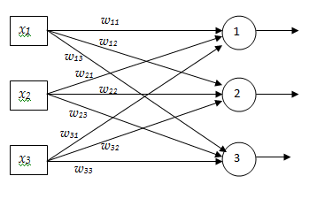
Self Organizing Maps
Example
Consider following 1-D SOM and 3-D inputs. Show the working of SOM for the given two inputs.
x₁ | x₂ | x₃
0.1 | 0.2 | 0.13
0.5 | 0.3 | 0.7
Initial weight matrix
w₁₁=0.1 | w₁₂=0.2 | w₁₃=0.3
w₂₁=0.2 | w₂₂=0.4 | w₂₃=0.6
w₃₁=0.1 | w₃₂=0.3 | w₃₃=0.5

Slide 22
Self Organizing Maps
Solution
Iteration 1: input (0.1,0.2,0.13)
Find Euclidean distance between the input and weight vector of each output neuron
Clearly neuron 1 is winner

Slide 23
Self Organizing Maps
Update weights: Assume
We know that
=>

Slide 24
Self Organizing Maps
Similarly

Slide 25
Self Organizing Maps
Iteration 2: input (0.5,0.3,0.7)
Find Euclidean distance between the input and weight vector of each output neuron
Clearly neuron ? is winner

Slide 26
Self Organizing Maps
Update weights

Slide 27
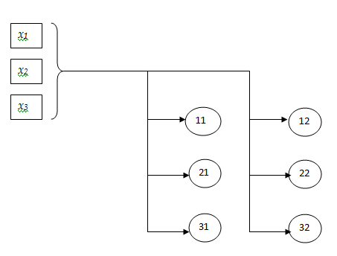
Self Organizing Maps
Example
Consider following 2-D SOM and 3-D inputs. Show the working of SOM for the inputs (0.25,0.15,0.55)
Initial weight matrix
0.1 | 0.2 | 0.4 | 0.2 | 0.1 | 0.2
0.4 | 0.3 | 0.2 | 0.5 | 0.7 | 0.6
0.7 | 0.5 | 0.6 | 0.3 | 0.4 | 0.3

Slide 28
Vector Quantization
Vector quantization (VQ) is a lossy data compression technique.
In VQ, a codebook is used to approximate each input vector.
Every input vector is assigned to the nearest vector in the codebook.
The quantization process can be decomposed into two operations: Encoder and Decoder.
Encoder maps every input vector with some index and decoder maps every index with nearest code vector of the input vector.

Slide 29
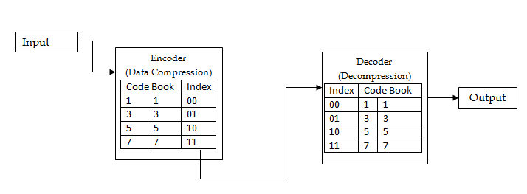
Vector Quantization
Example: Compress the input {(1,5),(2,3),(4,3),(4,1),(6,3), (5,4), (6,3), (8,4)} using codebook {(1,1),(3,3),(5,5), (7,7)}

Slide 30
Vector Quantization
Lets take input x=(1,5)
Thus, (1,5) is matched with (3,3)=> code for (1,5) is 01
Similarly, other inputs can be quantized

Slide 31
Vector Quantization
Without VQ
We need 3 bits to represent 8 inputs
Thus, total number of bits=8 x 3=24 bits
After VQ:
2 bits are needed to represent 4 code vectors
Thus, total number of bits=8 x 2=16 bits

Slide 32
Learning Vector Quantization (LVQ)
LVQ is prototype based supervised classification algorithm that uses competitive learning algorithm for training neural network.
Training algorithm used by LVQ is similar to SOM except slight different in weight update.
LVQ has two layers, one is the Input layer and the other one is the Output layer.
The architecture of the Learning Vector Quantization with the m number of classes in an input data and n number of input features for any sample is given below:

Slide 33
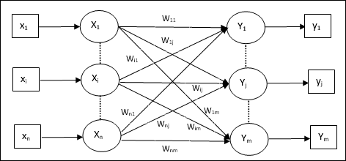
Learning Vector Quantization (LVQ)

Slide 34
Learning Vector Quantization (LVQ)
Algorithm
From the given set of training vectors, take the first m (i.e number of clusters) training vectors and use them as weight vectors. The remaining vectors can be used for training.
For each training vector x
Calculate Euclidean distance between x and weight vector of each neuron
Find index of winning neuron (say, J) such that Euclidean distance is minimum.

Slide 35
Learning Vector Quantization (LVQ)
Algorithm contd..
Update weights of winning neuron as below.
Repeat steps 2-3 until stopping condition is satisfied.

Slide 36
Learning Vector Quantization (LVQ)
Example
Construct an LVQ net with five vectors assigned to two classes. Given vectors along with classes is shown below.
Vector | Class
[0 0 1 1] | 1
[1 0 0 0] | 2
[0 0 0 1] | 2
[1 1 0 0] | 1
[0 1 1 0] | 1

Slide 37
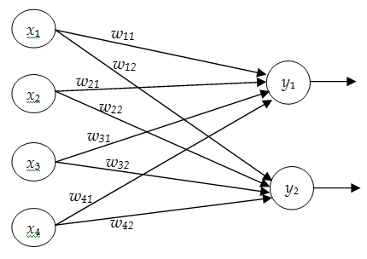
Learning Vector Quantization (LVQ)
Solution
Here every input has four features and two classes, so draw a network with four inputs and 2 outputs.

Slide 38
Learning Vector Quantization (LVQ)
Solution
Initialize weigh vector let
Take First Input vector x={0 0 0 1} T=2 (i.e class 2)
Calculate Euclidean distances:
Thus winning neuron is j=1 (i.e. y₁)

Slide 39
Learning Vector Quantization (LVQ)
Solution
Update weights (T≠J)
Thus, updated weight matrix is:

Slide 40
Learning Vector Quantization (LVQ)
Take Second Input vector x={1 1 0 0} T=1
Calculate Euclidean distances:
Thus, winning neuron is: j=2 (i.e. y₂)
Update weights (T≠J)

Slide 41
Learning Vector Quantization (LVQ)
Thus, updated weight matrix is:
Take Third Input vector x={0 1 1 0} T=1
Calculate Euclidean distances:
Thus, winning neuron is: j=1 (i.e. y₁)

Slide 42
Learning Vector Quantization (LVQ)
Update weights (T=J)
Thus, weigh matrix is

